Slide 1
PPT 非文本元素图库
历史生成文件提取 · 视觉去重 · 分类组件包
8
14
518
334
历史 PPTX
来源页
原始候选
去重元素
打开同目录 catalog.html 可搜索；各分类 components.pptx 每页保存一个可复制组件。
Notes:
[Sources]
- Project-local historical PPTX files listed in manifest.json.

Slide 2
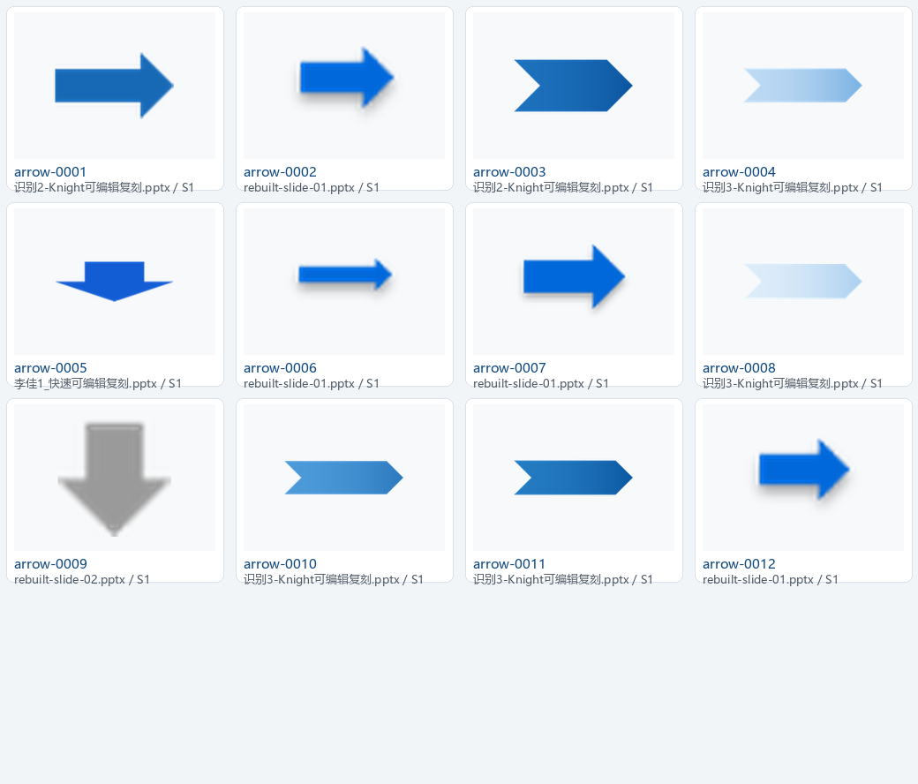
箭头与流程块
12 个元素 · 预览 1/1
Notes:
[Sources]
- Extracted project-local PPTX elements; see arrows/manifest.json.

Slide 3
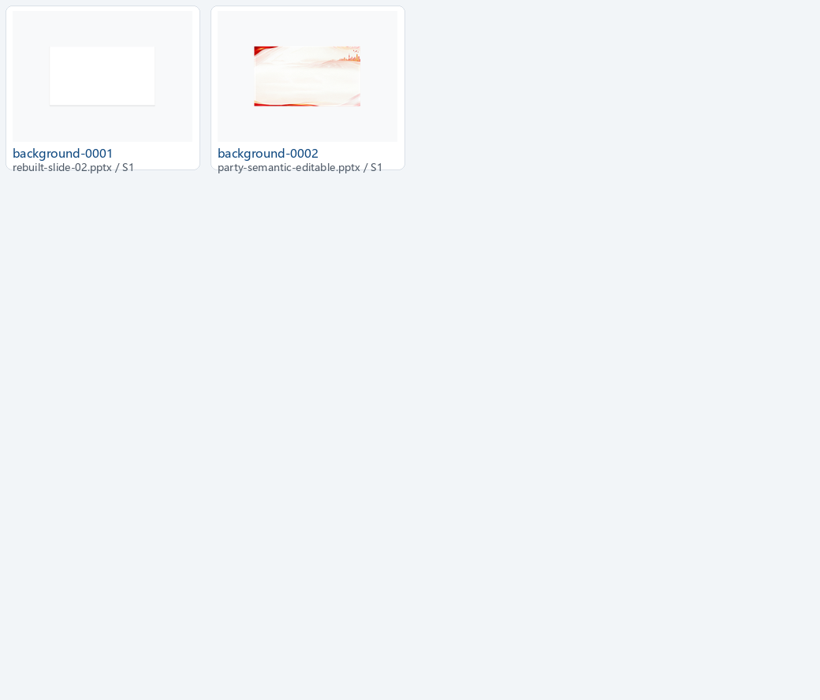
背景
2 个元素 · 预览 1/1
Notes:
[Sources]
- Extracted project-local PPTX elements; see backgrounds/manifest.json.

Slide 4
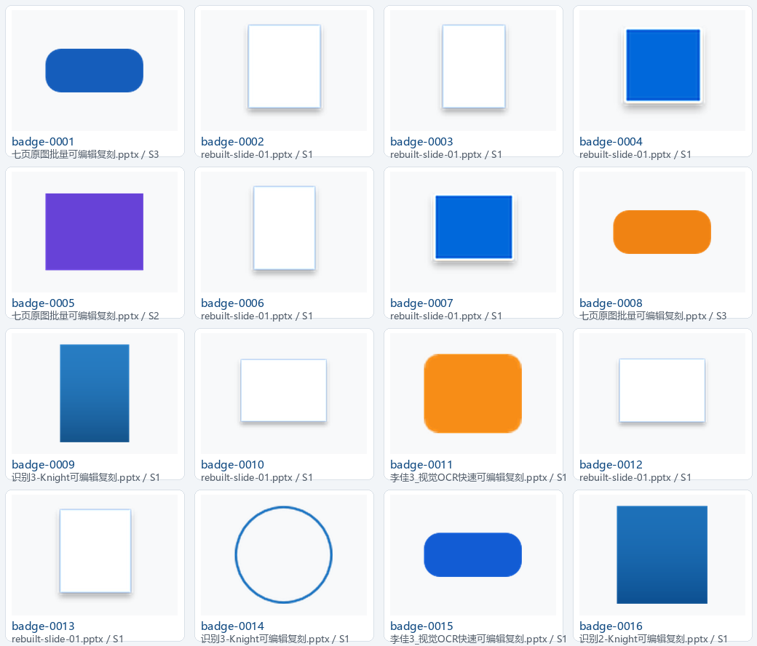
徽章与标签
50 个元素 · 预览 1/4
Notes:
[Sources]
- Extracted project-local PPTX elements; see badges/manifest.json.

Slide 5
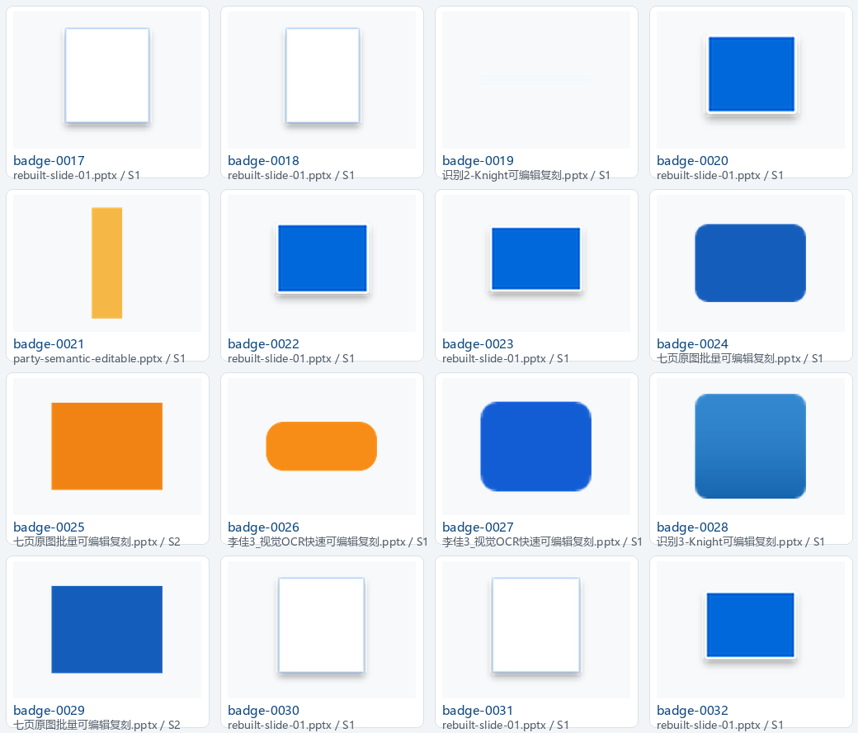
徽章与标签
50 个元素 · 预览 2/4
Notes:
[Sources]
- Extracted project-local PPTX elements; see badges/manifest.json.

Slide 6
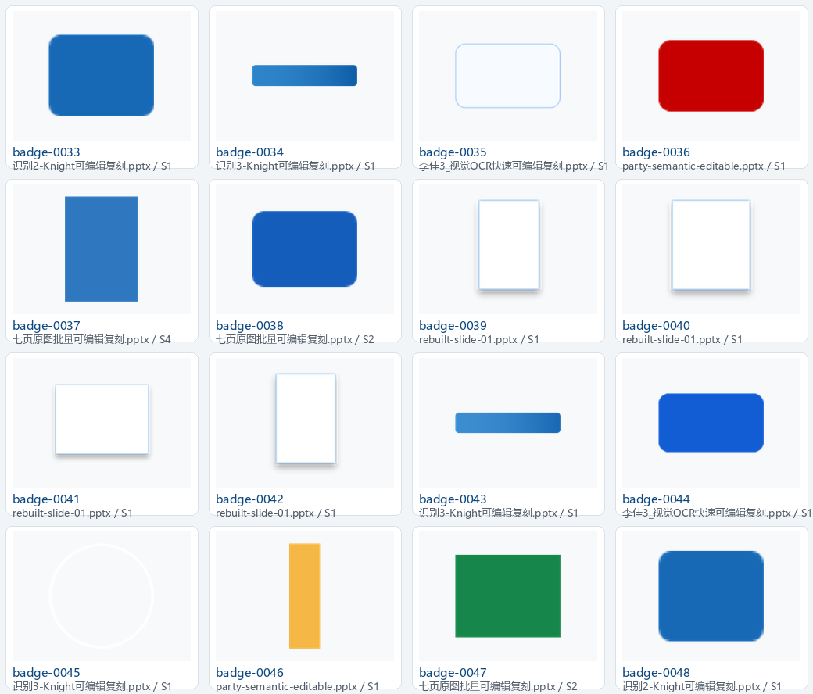
徽章与标签
50 个元素 · 预览 3/4
Notes:
[Sources]
- Extracted project-local PPTX elements; see badges/manifest.json.

Slide 7
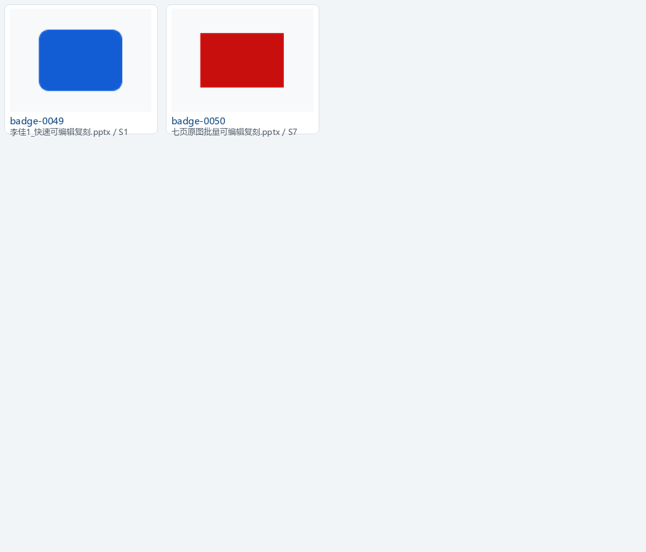
徽章与标签
50 个元素 · 预览 4/4
Notes:
[Sources]
- Extracted project-local PPTX elements; see badges/manifest.json.

Slide 8
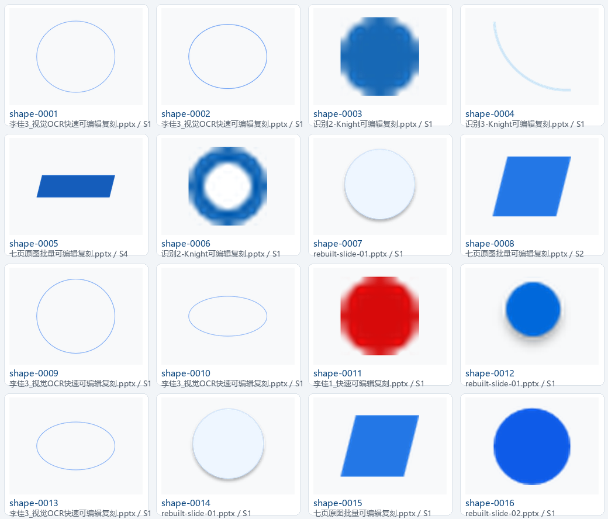
基础形状
39 个元素 · 预览 1/3
Notes:
[Sources]
- Extracted project-local PPTX elements; see basic_shapes/manifest.json.

Slide 9
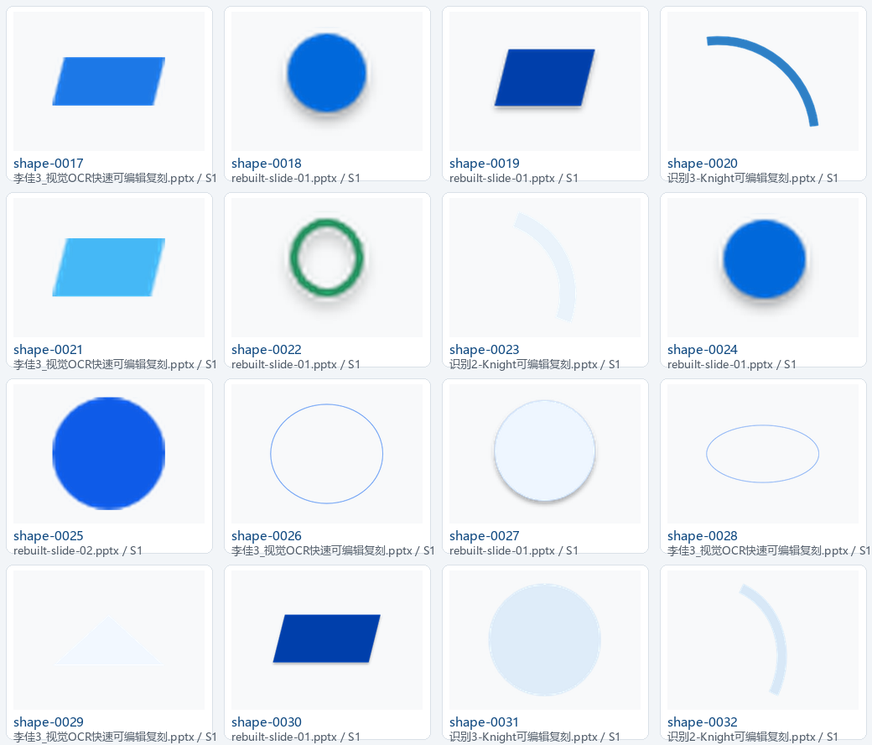
基础形状
39 个元素 · 预览 2/3
Notes:
[Sources]
- Extracted project-local PPTX elements; see basic_shapes/manifest.json.

Slide 10
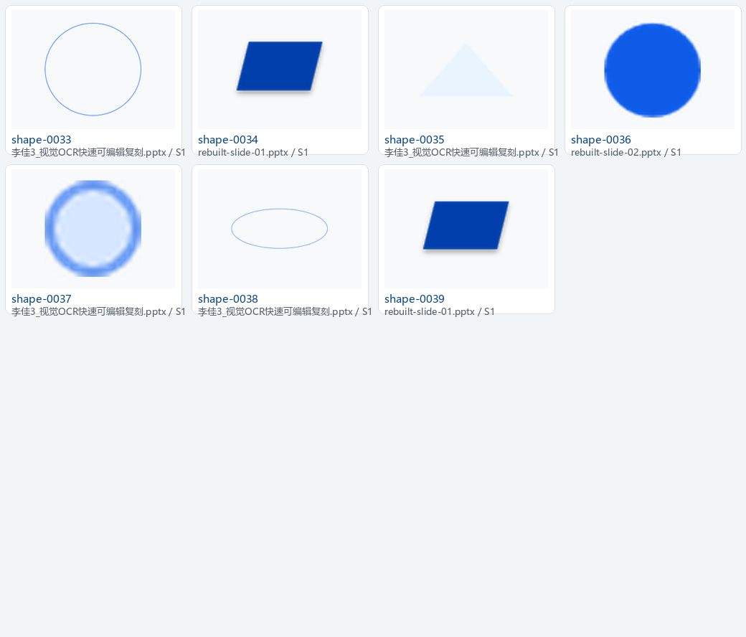
基础形状
39 个元素 · 预览 3/3
Notes:
[Sources]
- Extracted project-local PPTX elements; see basic_shapes/manifest.json.

Slide 11
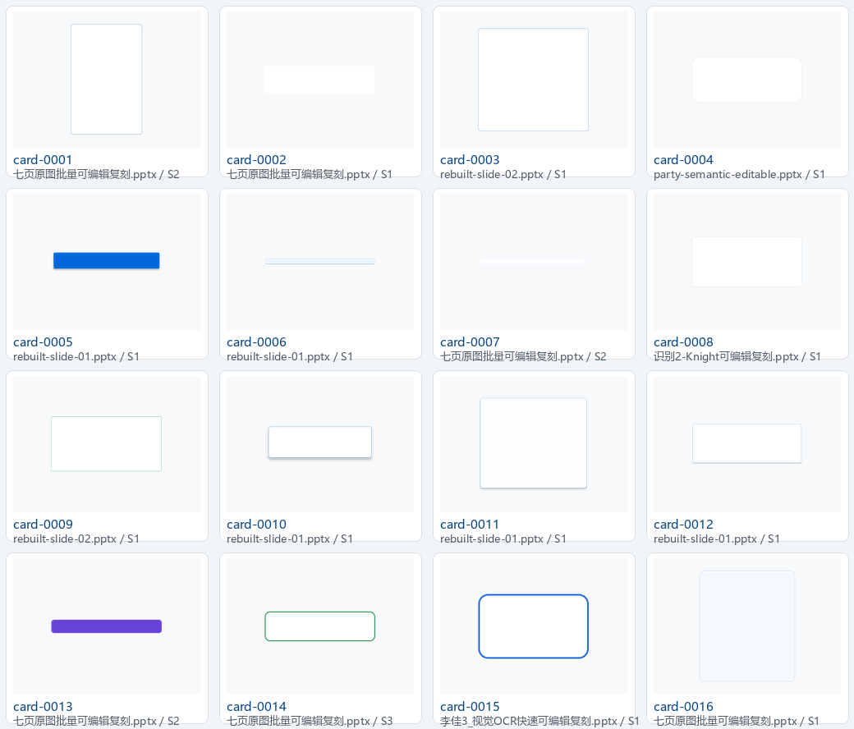
卡片与容器
121 个元素 · 预览 1/8
Notes:
[Sources]
- Extracted project-local PPTX elements; see cards/manifest.json.

Slide 12
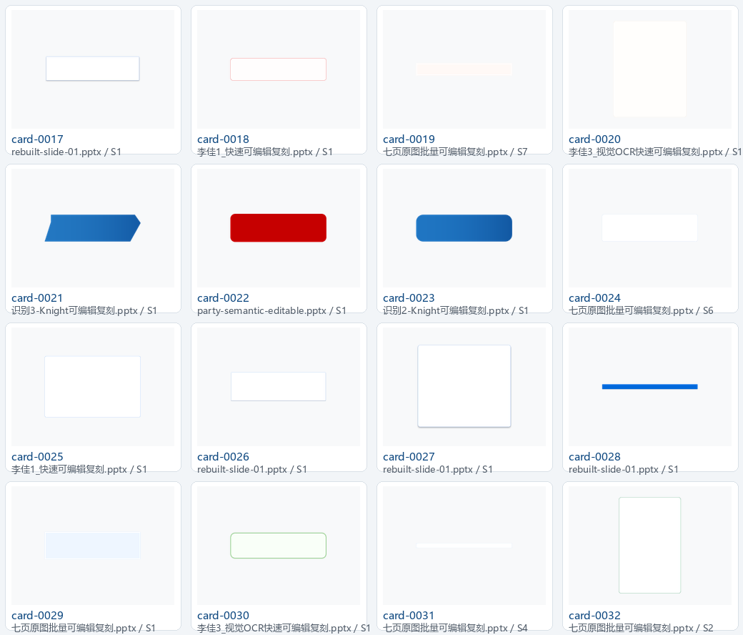
卡片与容器
121 个元素 · 预览 2/8
Notes:
[Sources]
- Extracted project-local PPTX elements; see cards/manifest.json.

Slide 13
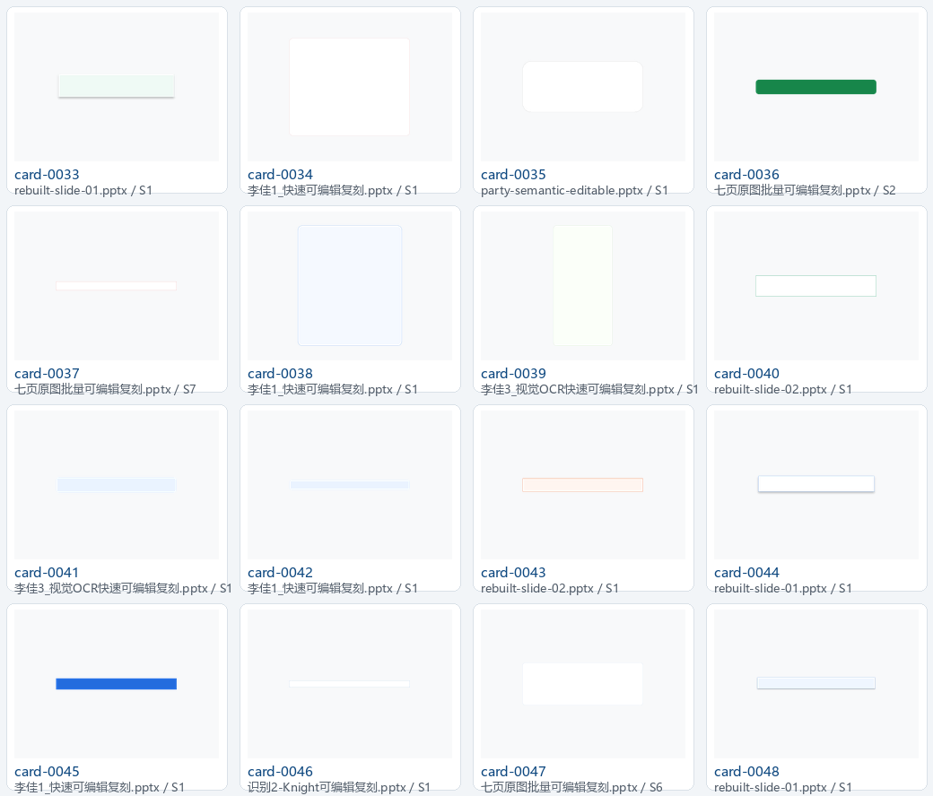
卡片与容器
121 个元素 · 预览 3/8
Notes:
[Sources]
- Extracted project-local PPTX elements; see cards/manifest.json.

Slide 14
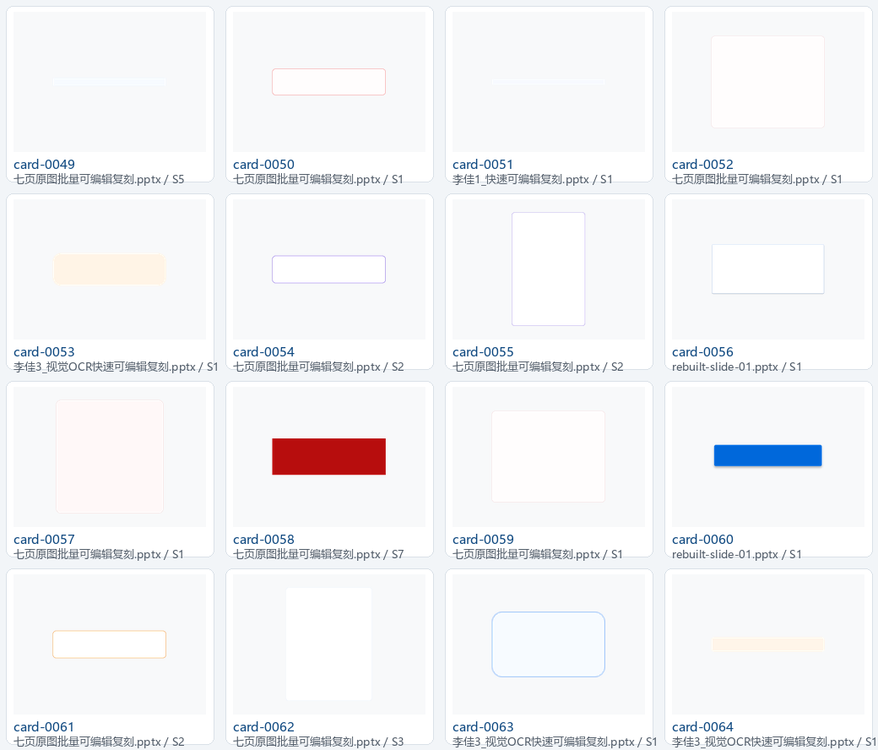
卡片与容器
121 个元素 · 预览 4/8
Notes:
[Sources]
- Extracted project-local PPTX elements; see cards/manifest.json.

Slide 15
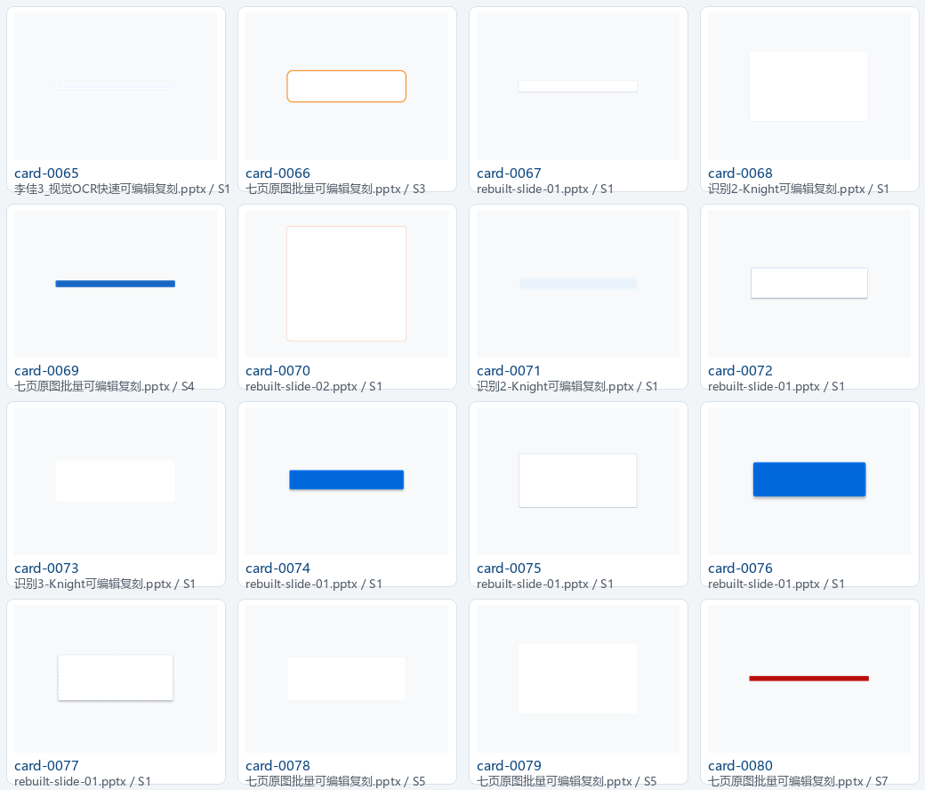
卡片与容器
121 个元素 · 预览 5/8
Notes:
[Sources]
- Extracted project-local PPTX elements; see cards/manifest.json.

Slide 16
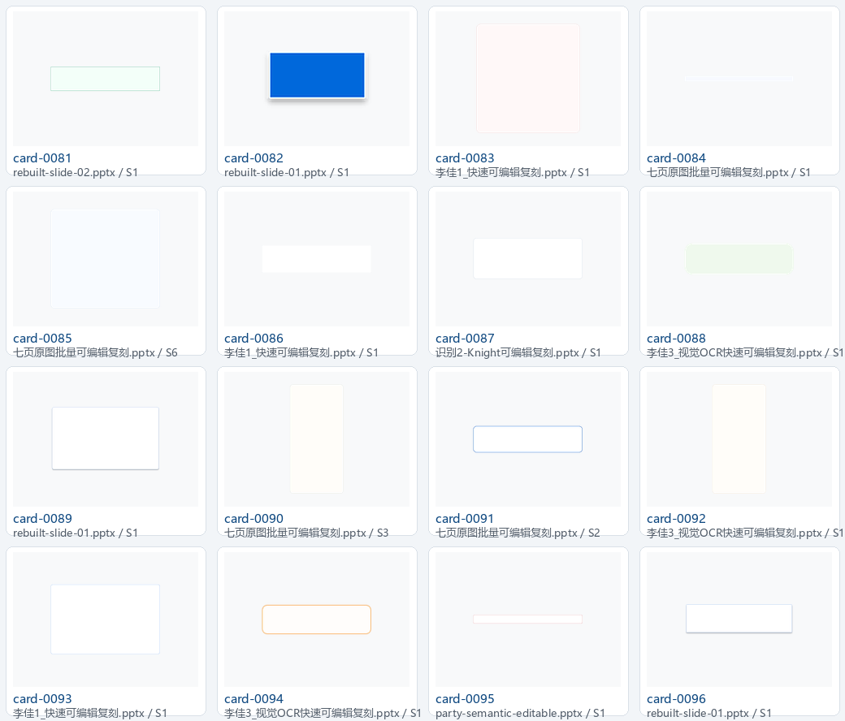
卡片与容器
121 个元素 · 预览 6/8
Notes:
[Sources]
- Extracted project-local PPTX elements; see cards/manifest.json.

Slide 17
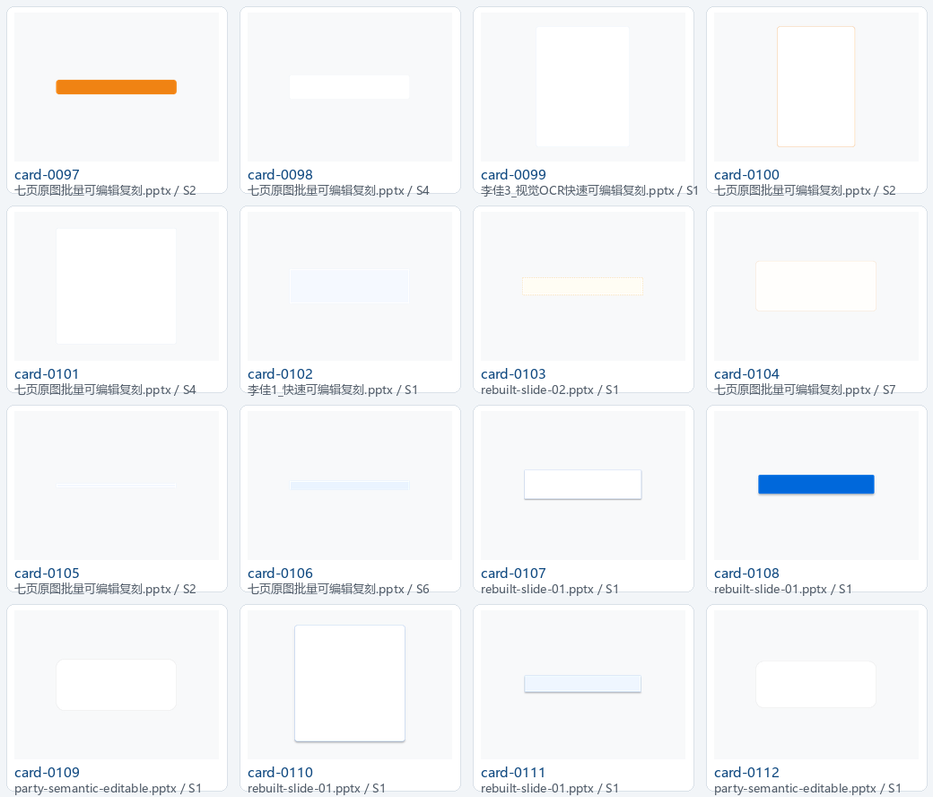
卡片与容器
121 个元素 · 预览 7/8
Notes:
[Sources]
- Extracted project-local PPTX elements; see cards/manifest.json.

Slide 18
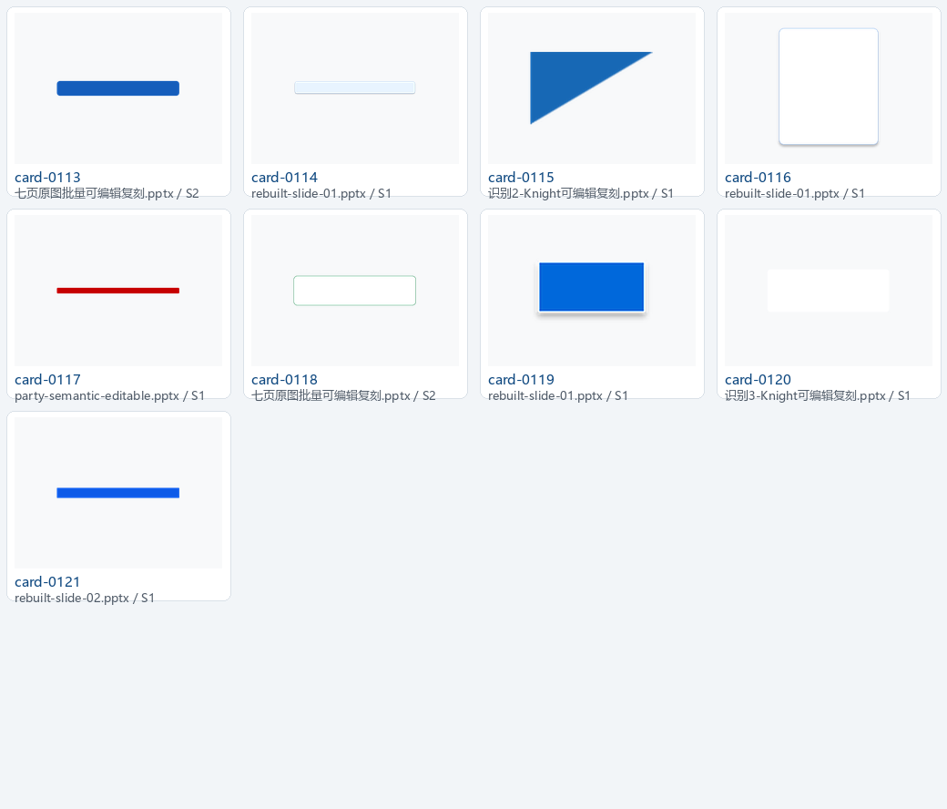
卡片与容器
121 个元素 · 预览 8/8
Notes:
[Sources]
- Extracted project-local PPTX elements; see cards/manifest.json.

Slide 19
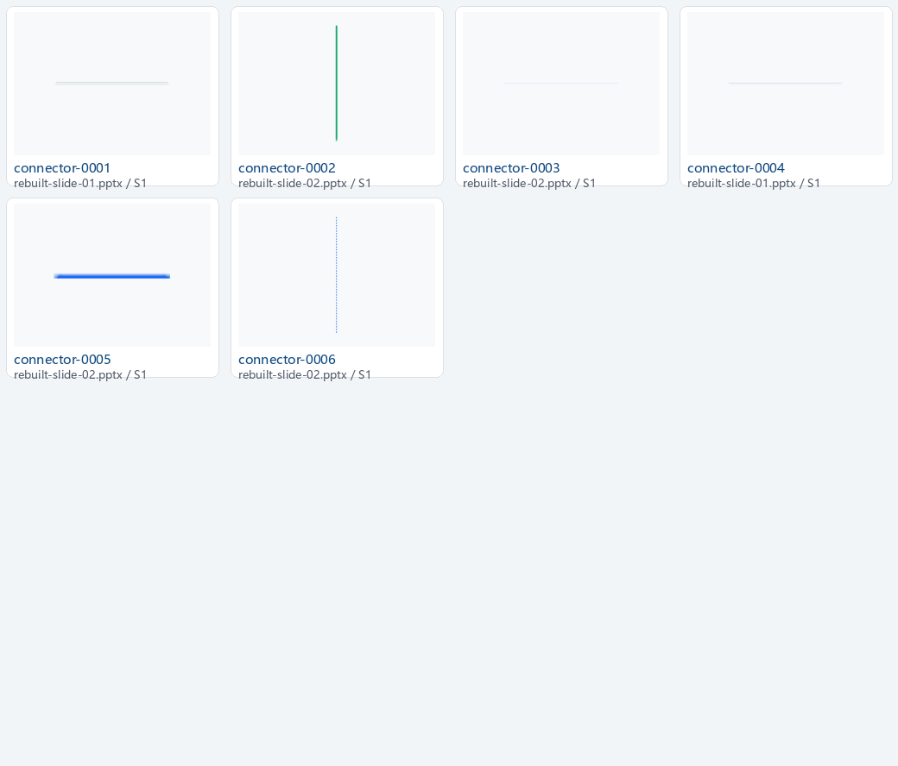
连接器
6 个元素 · 预览 1/1
Notes:
[Sources]
- Extracted project-local PPTX elements; see connectors/manifest.json.

Slide 20
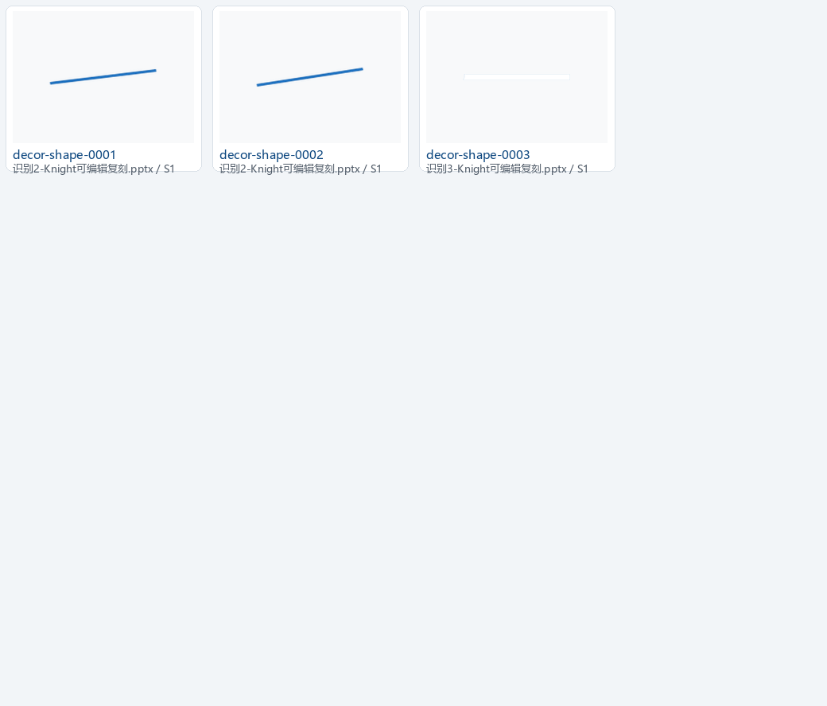
装饰形状
3 个元素 · 预览 1/1
Notes:
[Sources]
- Extracted project-local PPTX elements; see decorative_shapes/manifest.json.

Slide 21
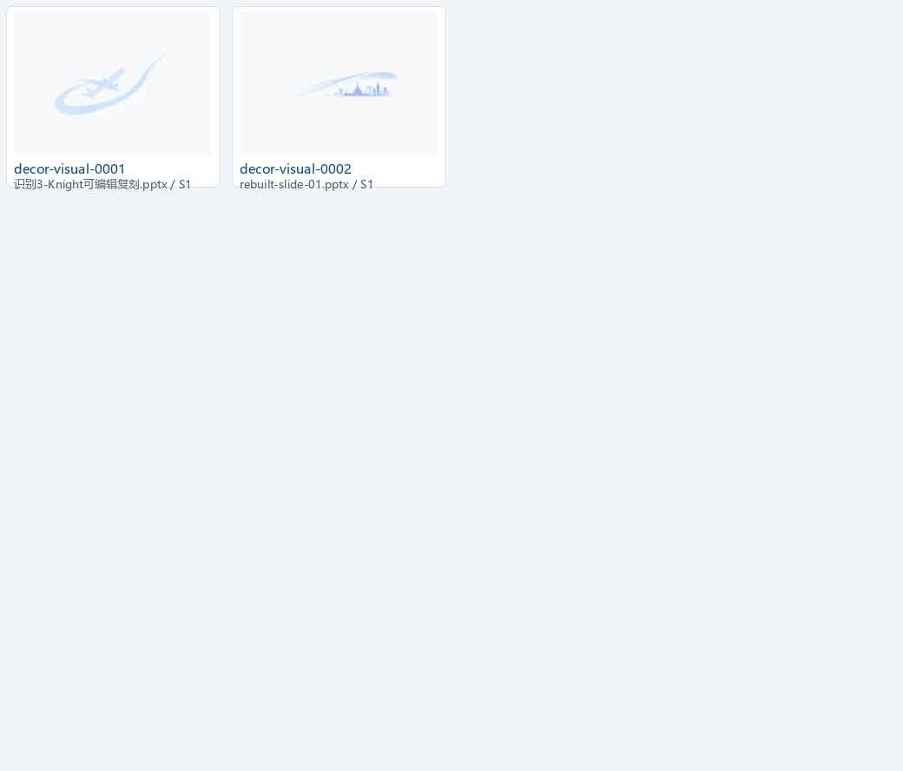
装饰视觉
2 个元素 · 预览 1/1
Notes:
[Sources]
- Extracted project-local PPTX elements; see decorative_visuals/manifest.json.

Slide 22
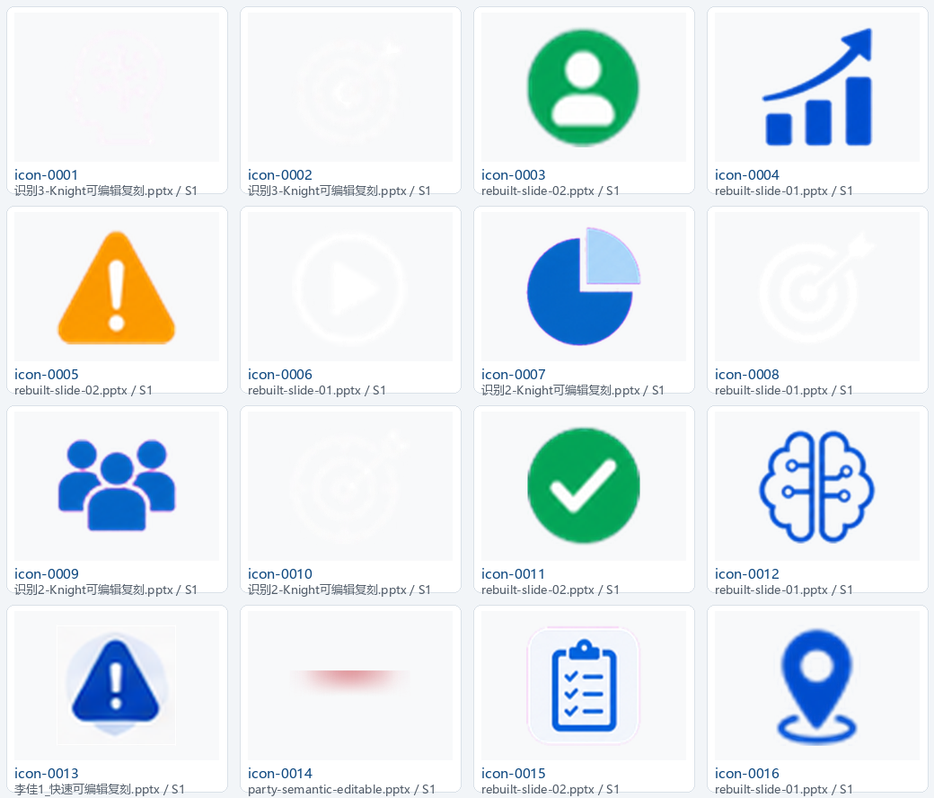
图标
68 个元素 · 预览 1/5
Notes:
[Sources]
- Extracted project-local PPTX elements; see icons/manifest.json.

Slide 23
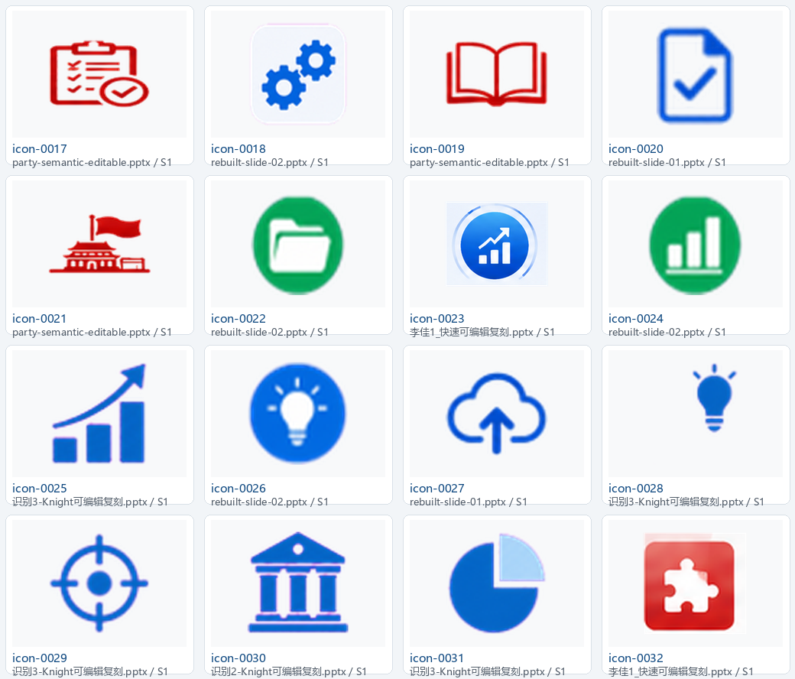
图标
68 个元素 · 预览 2/5
Notes:
[Sources]
- Extracted project-local PPTX elements; see icons/manifest.json.

Slide 24
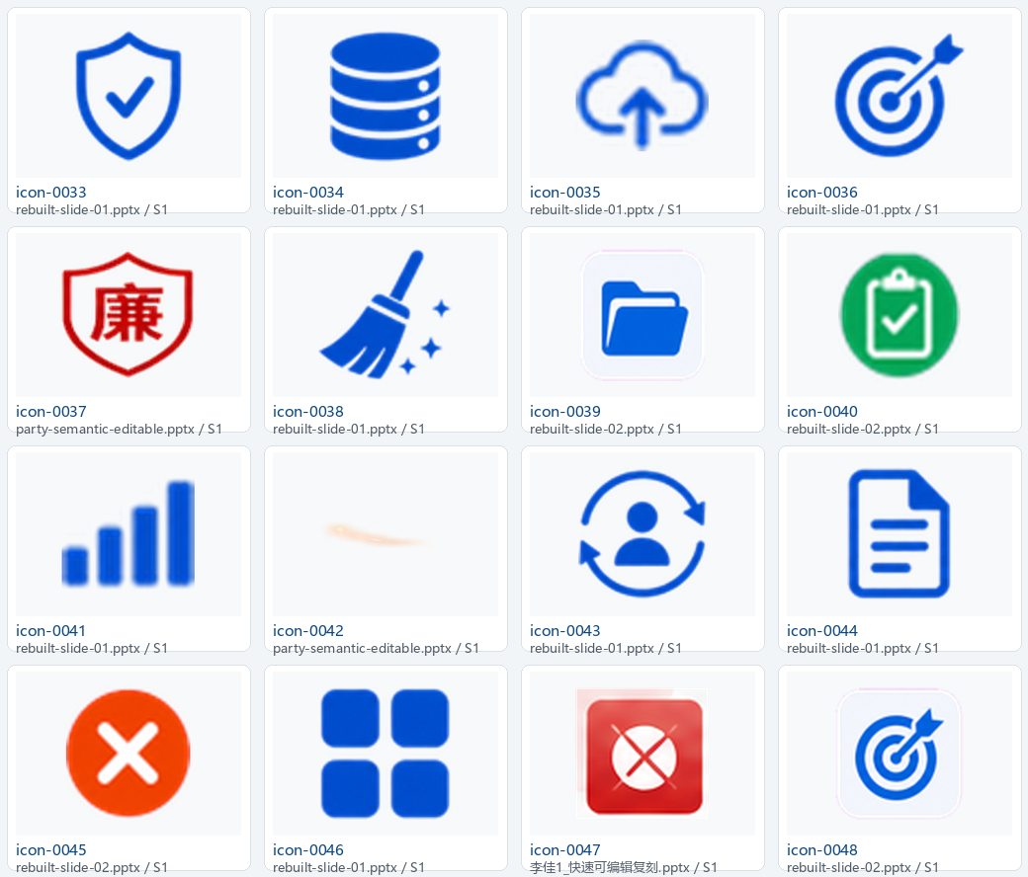
图标
68 个元素 · 预览 3/5
Notes:
[Sources]
- Extracted project-local PPTX elements; see icons/manifest.json.

Slide 25
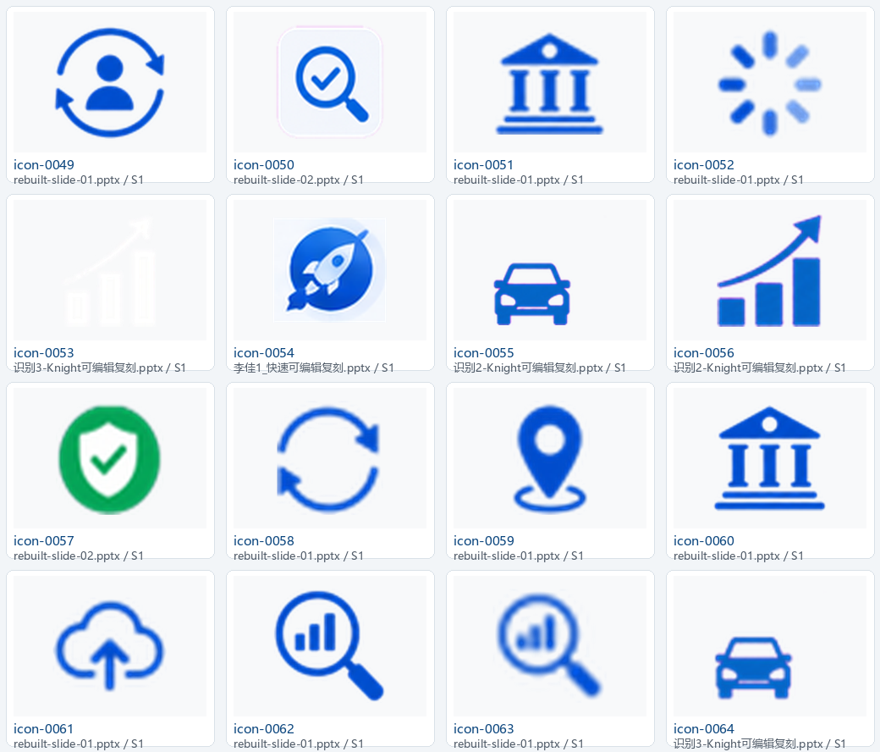
图标
68 个元素 · 预览 4/5
Notes:
[Sources]
- Extracted project-local PPTX elements; see icons/manifest.json.

Slide 26
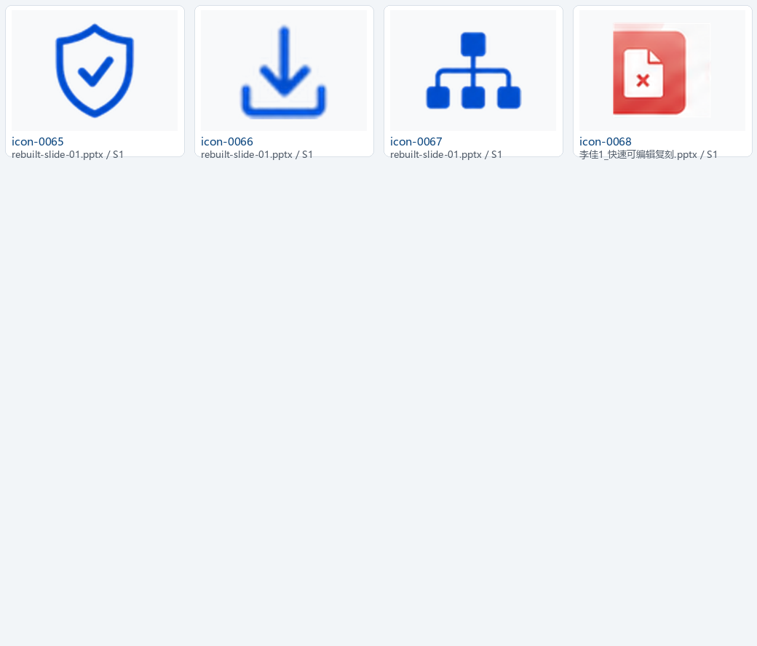
图标
68 个元素 · 预览 5/5
Notes:
[Sources]
- Extracted project-local PPTX elements; see icons/manifest.json.

Slide 27
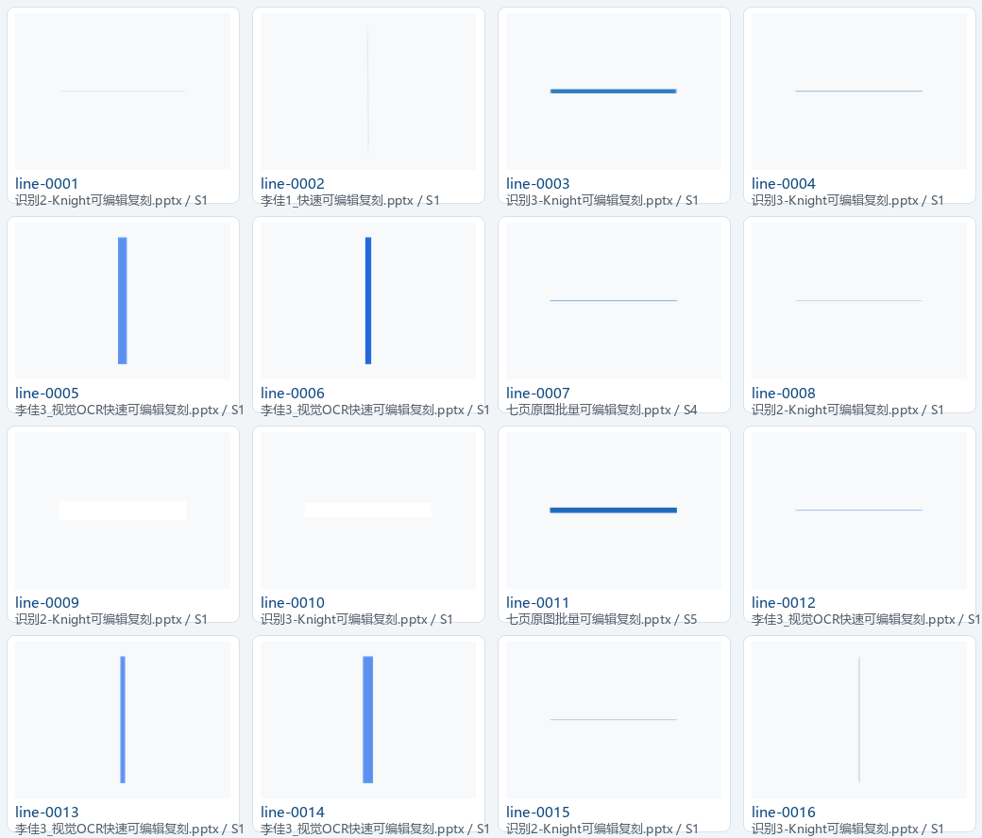
线条
27 个元素 · 预览 1/2
Notes:
[Sources]
- Extracted project-local PPTX elements; see lines/manifest.json.

Slide 28
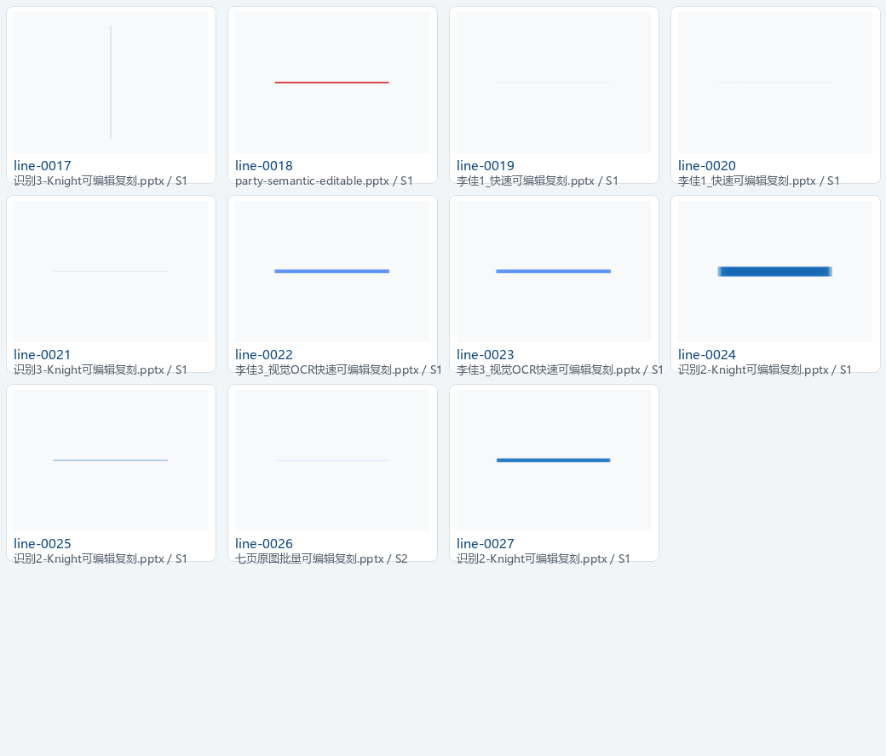
线条
27 个元素 · 预览 2/2
Notes:
[Sources]
- Extracted project-local PPTX elements; see lines/manifest.json.

Slide 29
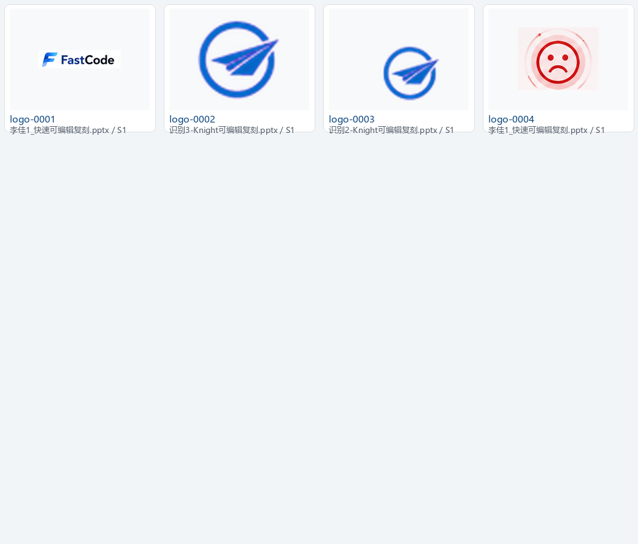
Logo 与品牌标志
4 个元素 · 预览 1/1
Notes:
[Sources]
- Extracted project-local PPTX elements; see logos/manifest.json.

